Slide 1
Orientation, Angular Displacement, Angular Velocity, and Angular Acceleration
Dr. Jacob Moore
Associate Professor of Engineering
Penn State Mont Alto

Slide 2


Position, Displacement, Velocity and Acceleration
In engineering mechanics, the concepts of orientation, angular displacement, angular velocity, and angular acceleration supplement the concepts of position, displacement, velocity, and acceleration to fully describe the motion of rigid, extended bodies.
These are necessary, because rigid bodies can both translate and rotate during motion.
$$t_{1}$$
$$t_{2}$$

Slide 3

Orientation
The concept of orientation describes how a body is currently rotated relative to a set neutral orientation.
By describing the position of a point on a rigid body (usually the center of mass) along with the current orientation, we can fully define the current location of a body
y
x
$$θ$$
y
x

Slide 4
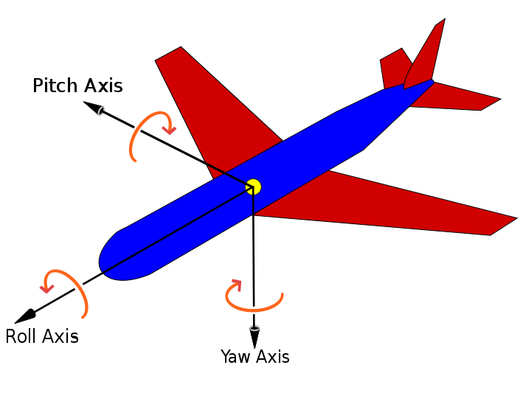
Orientation in 3D
In two-dimensional motion, a single angle is enough to define the orientation, however when we move to three-dimensional motion, we will find we need to define three angles to fully define the orientation of an object.
This corresponds to the relative rotation about each of the three axes.
Image by Jrvz CC-BY-SA 3.0

Slide 5

Angular Displacement
The angular displacement of a body is simply the change orientation of a body between two points in time.
In 2-D we can treat this as more or less a scalar value (the change in angle), but in 3-D this will need to be represented as a vector quantity, indicating the change in angle and the axis of rotation.
$$∆θ$$

Slide 6
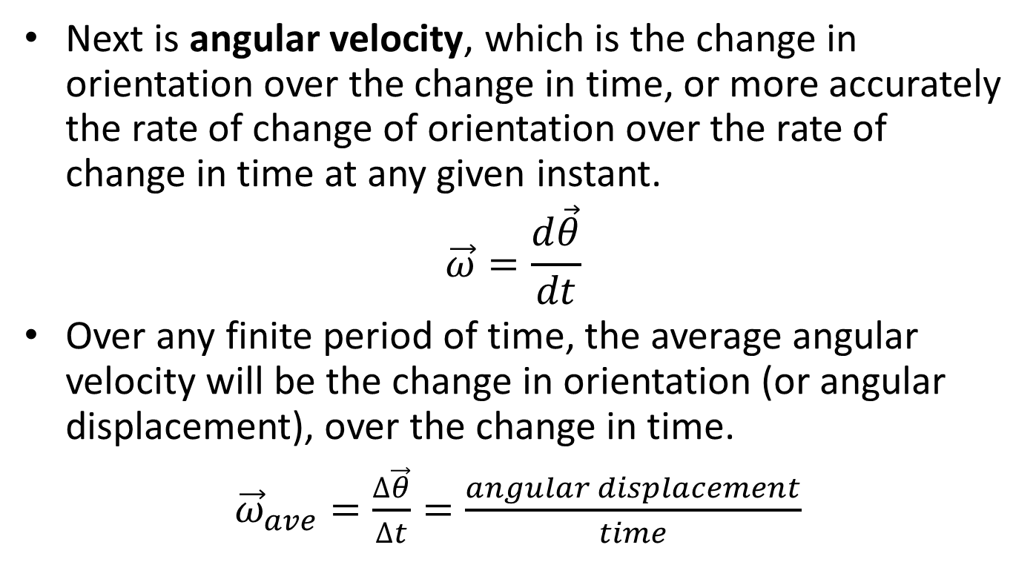
Angular Velocity
Next is angular velocity, which is the change in orientation over the change in time, or more accurately the rate of change of orientation over the rate of change in time at any given instant.
$$\vec{ω}=\frac{d\vec{θ}}{dt}$$
Over any finite period of time, the average angular velocity will be the change in orientation (or angular displacement), over the change in time.
${\vec{ω}}_{ave}=\frac{∆\vec{θ}}{∆t}=\frac{angular displacement}{time}$

Slide 7
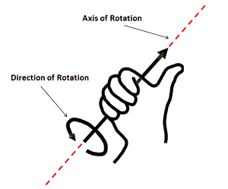

Angular Velocity
Just as with regular velocity, angular velocity is a vector quantity, meaning it has a magnitude and direction.
The angular velocity vector will lie along the axis of rotation, using the right hand rule to determine the direction.
Image by Piercetheorganist CC-BY-SA 3.0

Slide 8
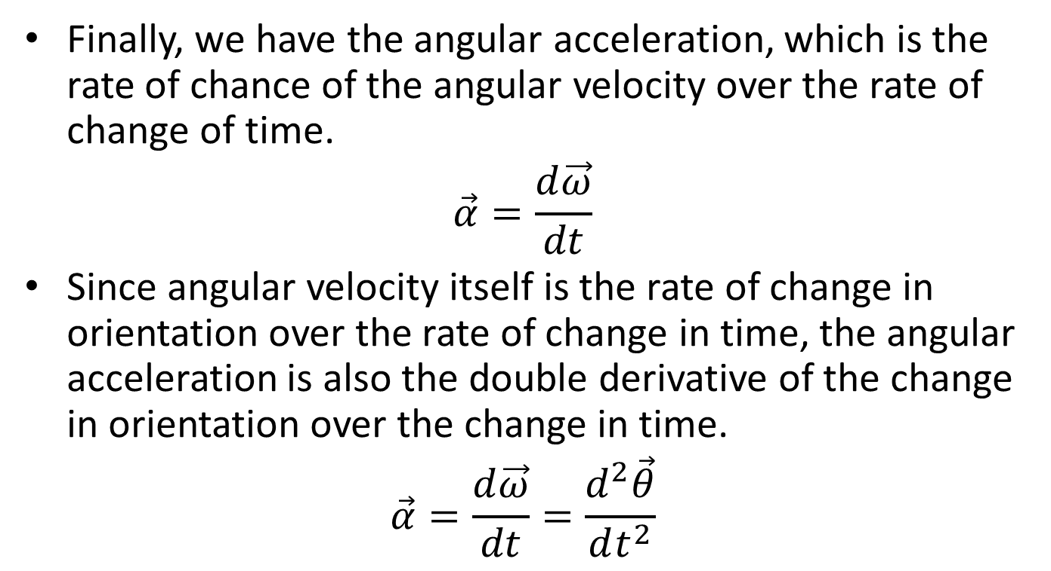
Angular Acceleration
Finally, we have the angular acceleration, which is the rate of chance of the angular velocity over the rate of change of time.
$$\vec{α}=\frac{d\vec{ω}}{dt}$$
Since angular velocity itself is the rate of change in orientation over the rate of change in time, the angular acceleration is also the double derivative of the change in orientation over the change in time.
$$\vec{α}=\frac{d\vec{ω}}{dt}=\frac{d^{2}\vec{θ}}{dt^{2}}$$

Slide 9
Angular Acceleration
Just as with angular displacement and with angular velocity, acceleration is a vector quantity, meaning that is has a magnitude and direction.
Again, the angular acceleration vector will lie along the axis of rotation, with the right hand rule being used to determine the direction.

Slide 10
Thanks for Watching
See other engineering mechanics videos and access the full tool at…

